Slide 1
SM-Module- 4
STRATEGY FORMULATION

Slide 2
CORPORATE STRATEGY
MBA205
STRATEGY FORMULATION
The business vision and mission, the process of developing vision and mission, the importance of vision and mission statement, characteristics of mission statement,
Long-term Objectives, Types of strategies, Levels of strategies,
Integration strategies, Intensive strategies, Diversification strategies, Defensive strategies,
Porters generic strategies, Blue Ocean Strategy.

Slide 3
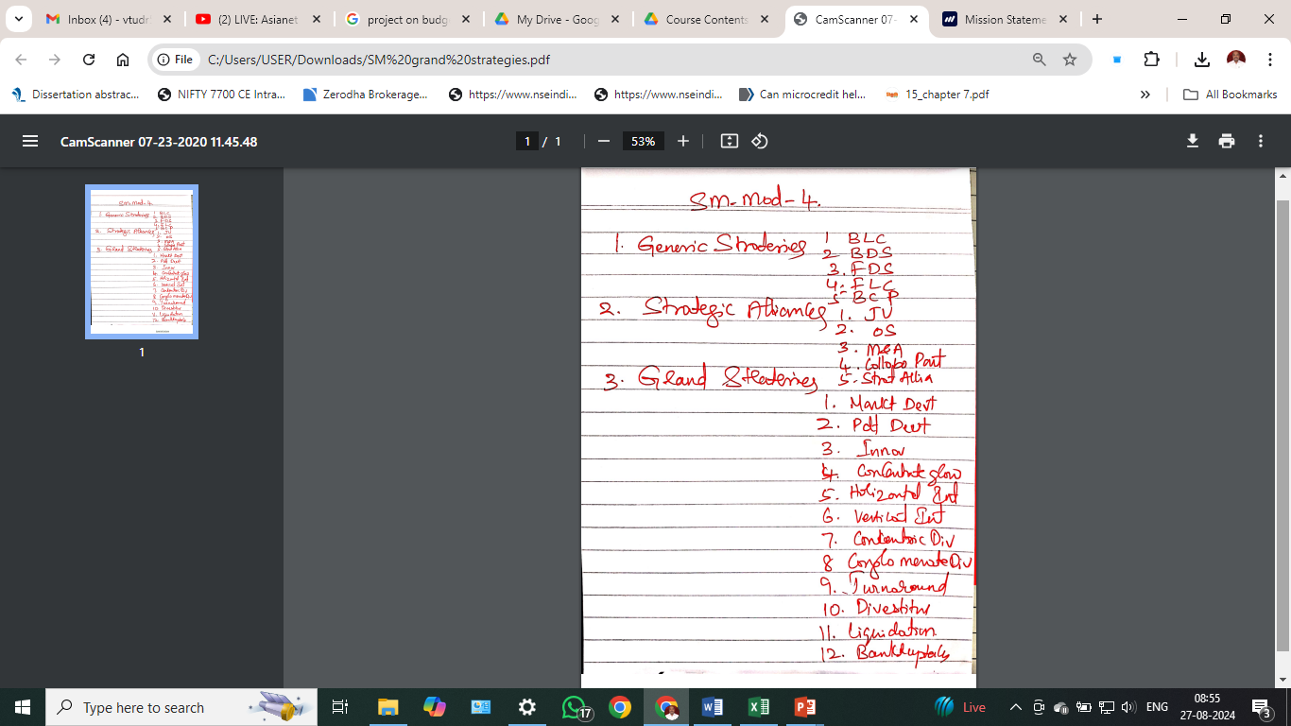


Slide 4
What is a Vision Statement?
A vision statement describes what a company desires to achieve in the long-run, generally in a time frame of five to ten years, or sometimes even longer. It depicts a vision of what the company will look like in the future and sets a defined direction for the planning and execution of corporate-level strategies.

Slide 5
Key Elements of a Good Vision Statement
While companies should not be too ambitious in defining their long-term goals, it is critical to set a bigger and further target in a vision statement that communicates a company’s aspirations and motivates the audience. Below are the main elements of an effective vision statement:
Forward-looking
Motivating and inspirational
Reflective of a company’s culture and core values
Aimed at bringing benefits and improvements to the organization in the future
Defines a company’s reason for existence and where it is heading

Slide 6
What is a Mission Statement?
A mission statement is a precise statement that defines what a company does and what purpose it serves. It is generally a short, 1-2 sentence statement that may incorporate the company’s corporate strategy and long-term vision.

Slide 7
Microsoft’s mission statement
Microsoft is an American multinational company that develops, manufactures, licenses, and sells technology products, including computer software, electronics, and personal computers. It is also one of the largest corporations in the world, alongside companies such as Apple, Inc. and Amazon.com, Inc.

Slide 8
“To empower every person and every organization on the planet to achieve more.”
The statement above is an example of a mission statement that provides a broad enough scale of scope to explain what the company does, and it is also inspirational and aspirational. It also defines Microsoft’s strategy, which is reaching out to the world and empowering all individuals and organizations.

Slide 9
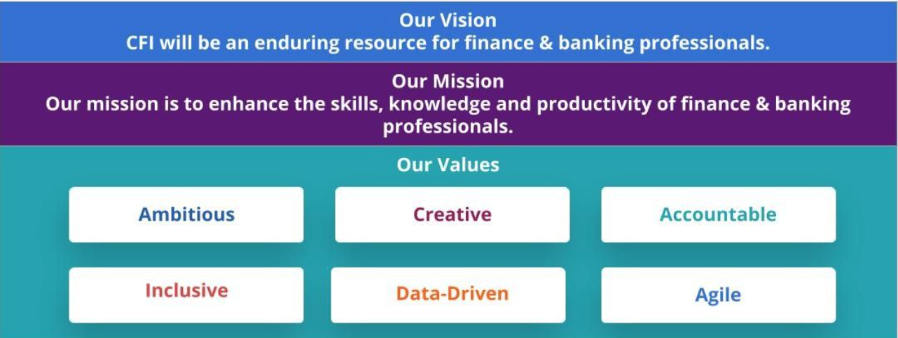

Slide 10
When creating a mission statement for a company, it can be helpful to create answers to these questions about the business:
What do we do?
Why do we do it?
Who do we do it for?
What would happen if we did not do this?
Why is this work important? Why does it matter?
While mission statements should be written to be as timeless and enduring as possible, it’s not uncommon to revise a mission statement as the company evolves over time. A business will review its statement periodically to ensure it captures the current mission of the company.

Slide 11
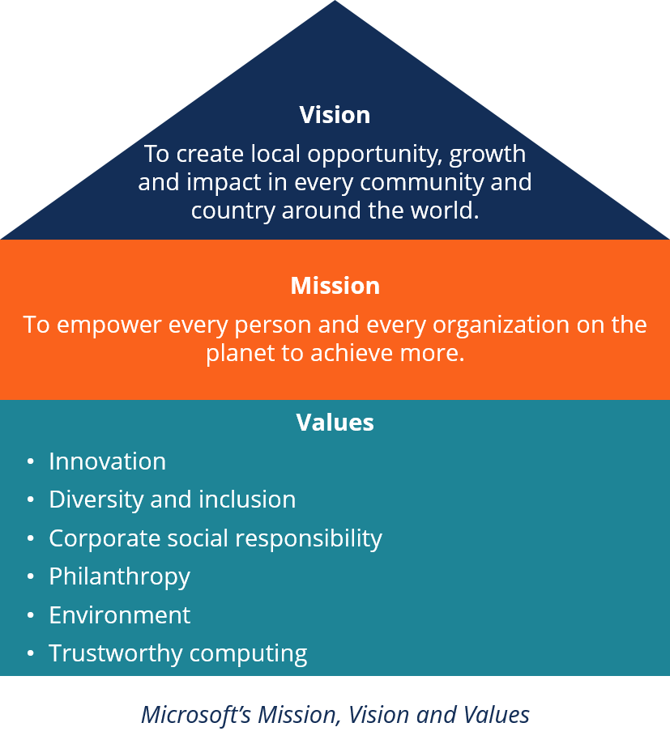

Slide 12
process of developing vision and mission

Slide 13
1. Define your end game
Start by understanding why your product or service matters. What does it help people do? How does it better their lives?
Think about our career personality test example for a moment. What’s the end result there?
Think of it this way: Your company is the road on which your customers are running a race. Once they cross the finish line, what do they get? This can help you see how what you’re doing makes a difference for your customers, your community, or even the world.

Slide 14
2. Pinpoint when you know you’ve made it
When you look five or 10 years down the road (let’s stop there for now), what fills out your win column? Jot down everything that comes to mind.
Turning back to our personality test scenario, do you want to become the world’s most trusted resource for career exploration?
Do you want to create a world where nobody hates their jobs?
Do you want every person to have confidence in their next career step?
Remember, this is your chance to be ambitious and be bold, so don’t be timid.

Slide 15
3. Pull together your vision
Ok, you’re almost there. You have two elements locked down:
What you ultimately produce and why it matters
How you’ll know when you’re successful
Now, similarly to what you did with your mission statement, it’s time to start piecing them together using different combinations and wording to see what you come up with.

Slide 16
Long-Term Objectives
Strategic managers recognize that short-run profit maximization is rarely the best approach to achieving sustained corporate growth and profitability
To achieve long-term prosperity, strategic planners commonly establish long-term objectives in seven areas:
  Profitability – Productivity
  Competitive Position – Employee Development
  Employee Relations – Productivity
  Tech Leadership – Public Responsibility

Slide 17
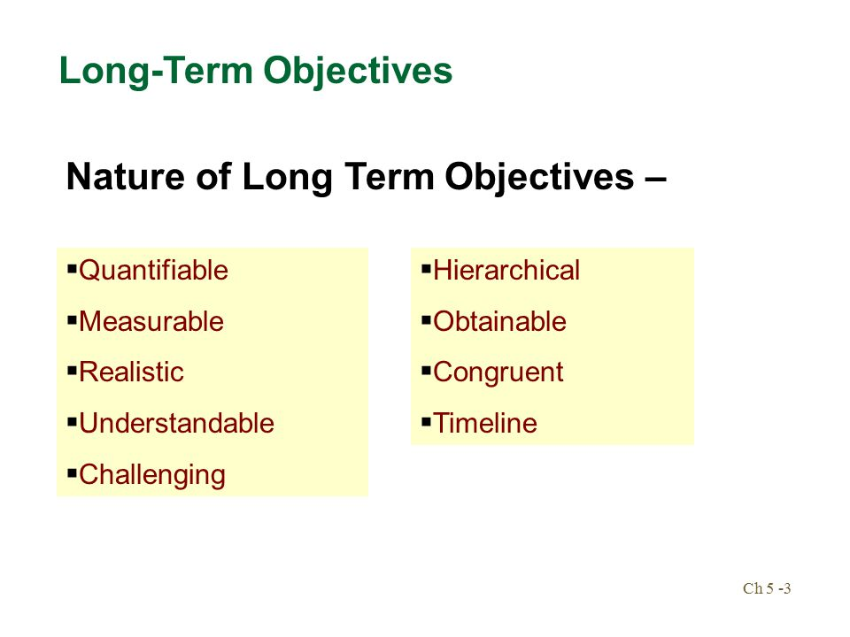

Slide 18
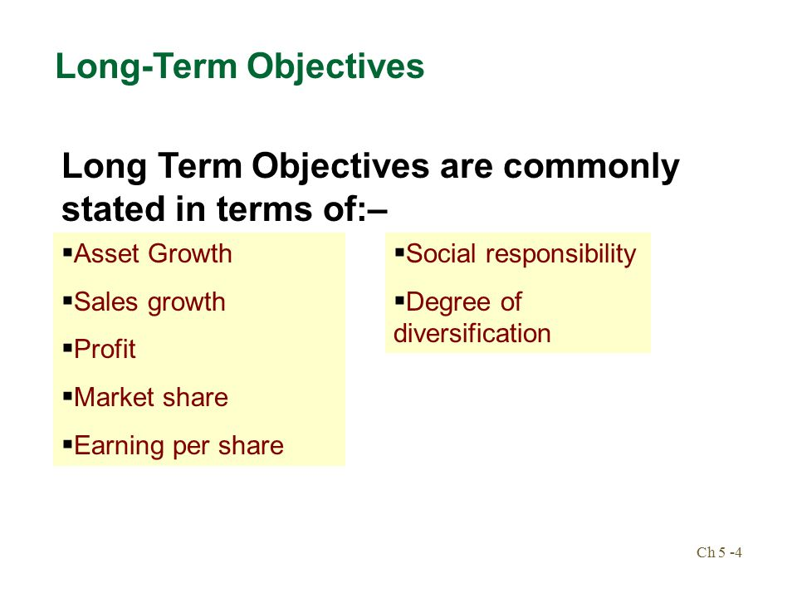

Slide 19
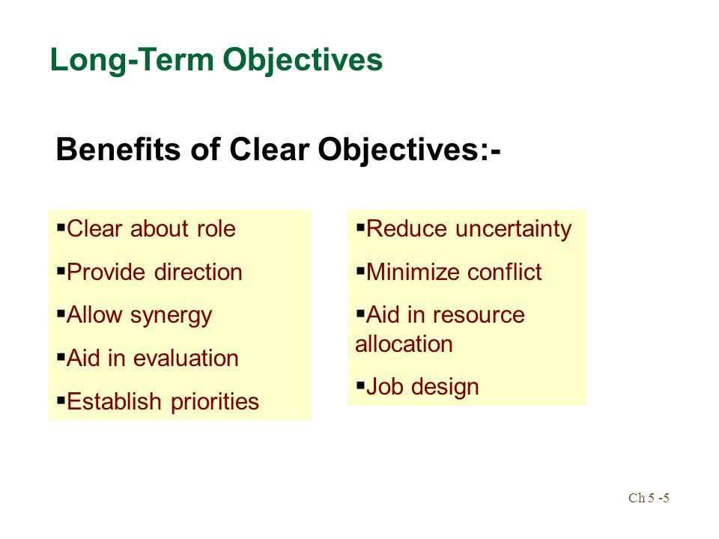

Slide 20
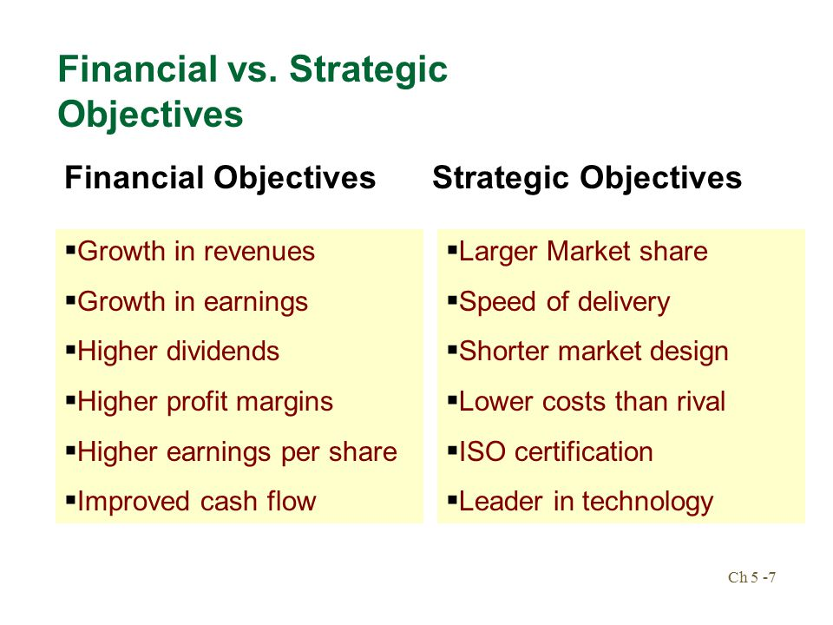

Slide 21
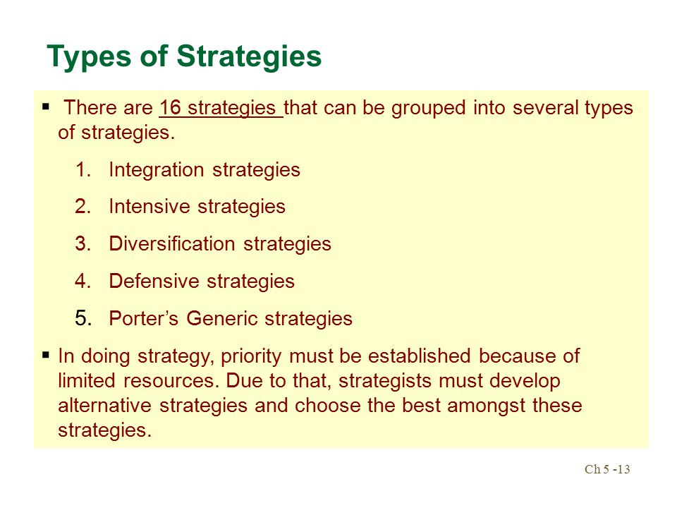

Slide 22
1 | Integration strategies
 | Vertical Integration
 | Forward Integration
 | Backward Integration
 | Horizontal Integration
2 | Intensive strategies
 | Market Penetration
 | Market Development
 | Product Development
3 | Diversification strategies
 | Concentric Diversification
 | Conglomerate Diversification
4 | Defensive strategies
 | Turnaround Strategies
 | Divestment Strategies
 | Liquidation Strategies
5 | Porter's Generic strategies
 | Broad Low-Cost Strategy
 | Broad Differentiation Strategy
 | Focussed Low-Cost Strategy
 | Focussed Differentiation Strategy
 | Best Cost Provider Strategy

Slide 24
Grand and Generic Strategies
1 | Integration strategies | 4 | Defensive strategies
1 | Vertical Integration | 9 | Turnaround Strategies
2 | Forward Integration | 10 | Divestment Strategies
3 | Backward Integration | 11 | Liquidation Strategies
4 | Horizontal Integration | 5 | Porter's Generic strategies
2 | Intensive strategies | 12 | Broad Low-Cost Strategy
4 | Market Penetration | 13 | Broad Differentiation Strategy
5 | Market Development | 14 | Focussed Low-Cost Strategy
6 | Product Development | 15 | Focussed Differentiation Strategy
3 | Diversification strategies | 16 | Best Cost Provider Strategy
7 | Concentric Diversification
8 | Conglomerate Diversification

Slide 25
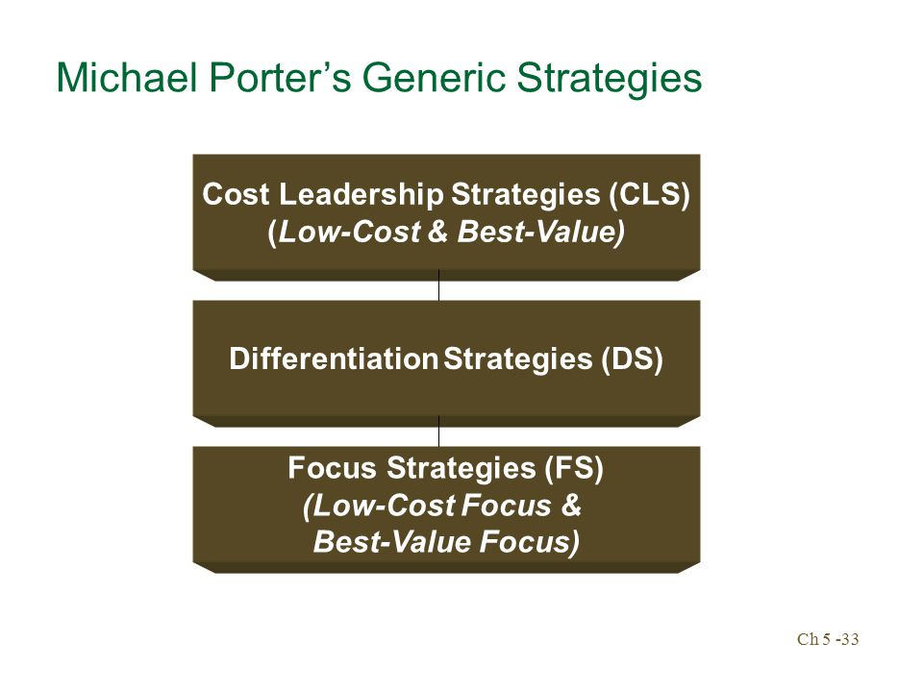

Slide 26
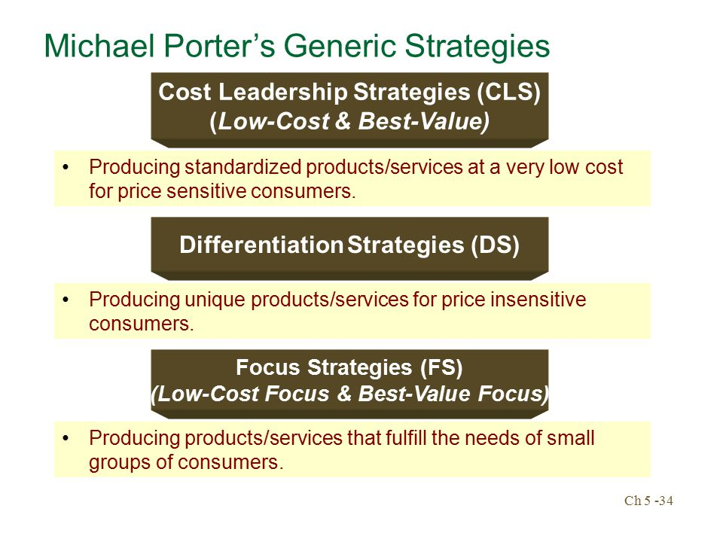

Slide 27
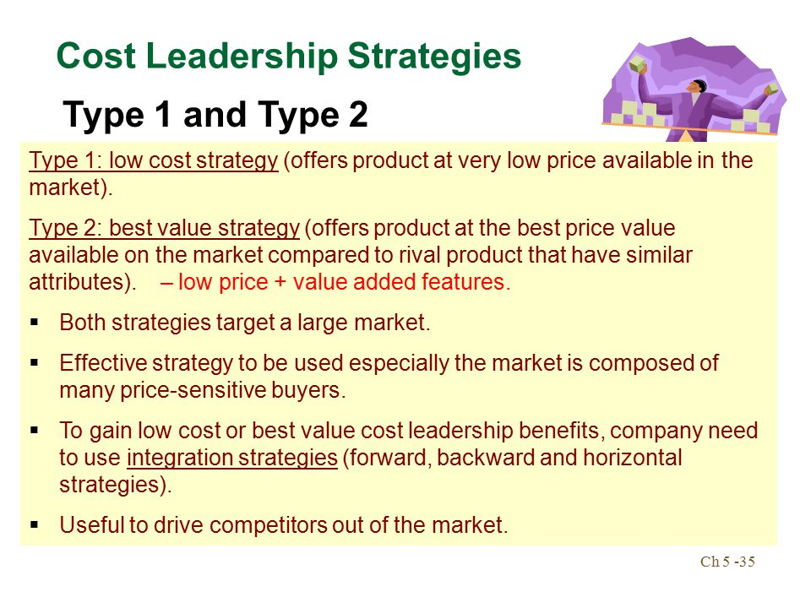

Slide 28
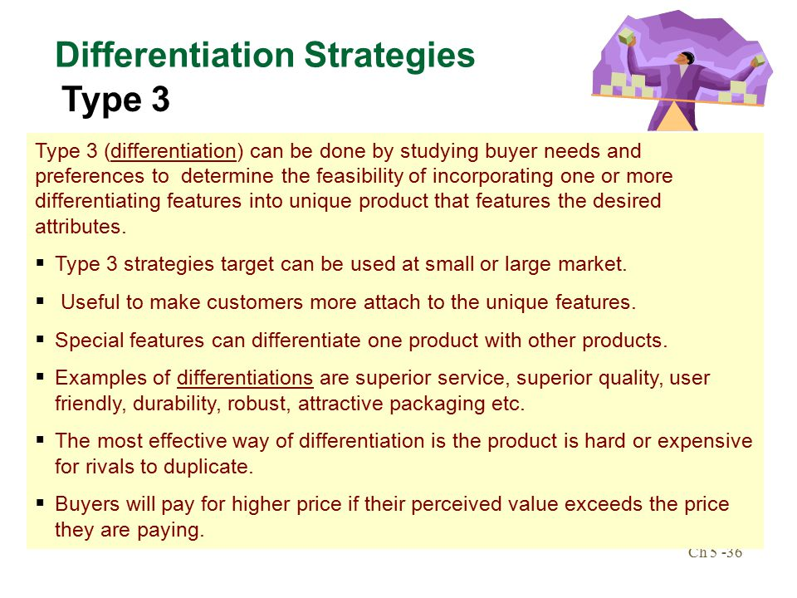

Slide 29
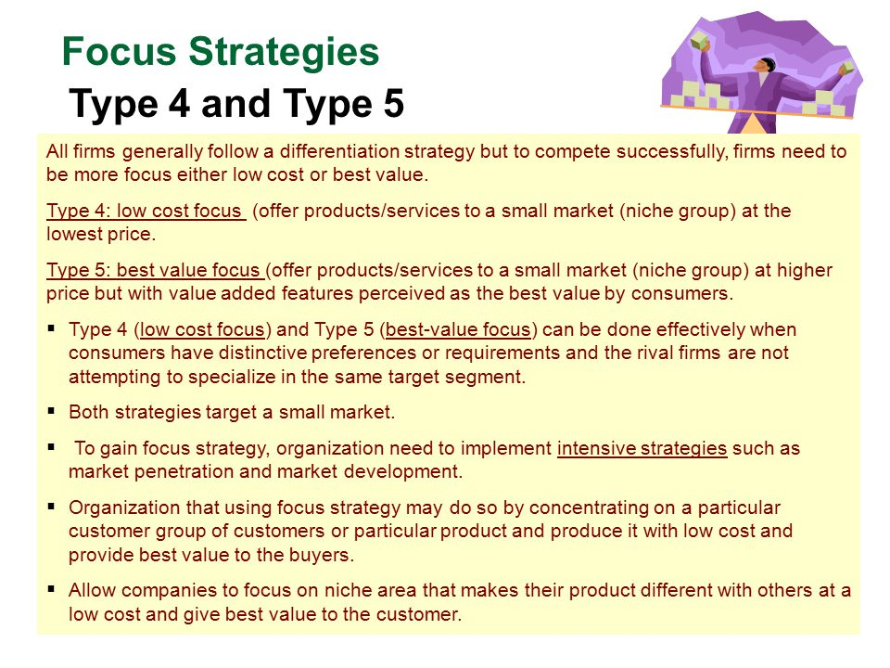

Slide 30
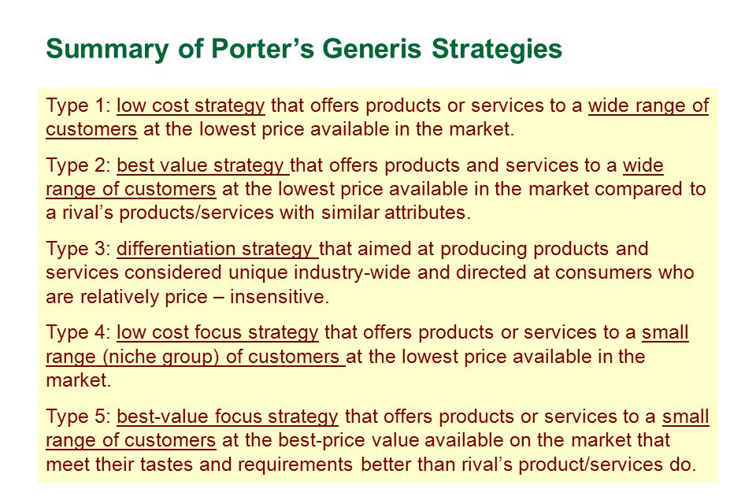

Slide 32
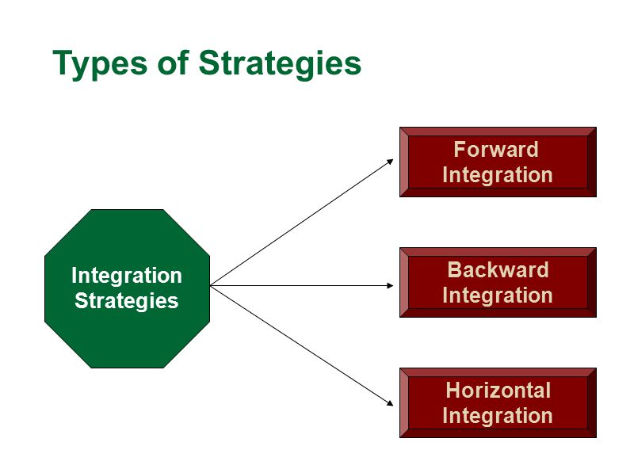

Slide 33
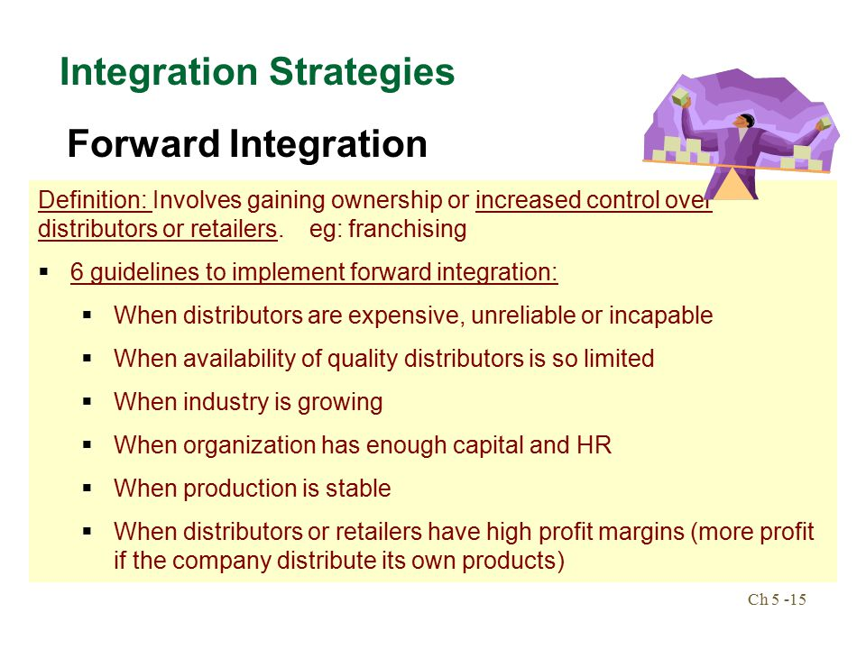

Slide 34
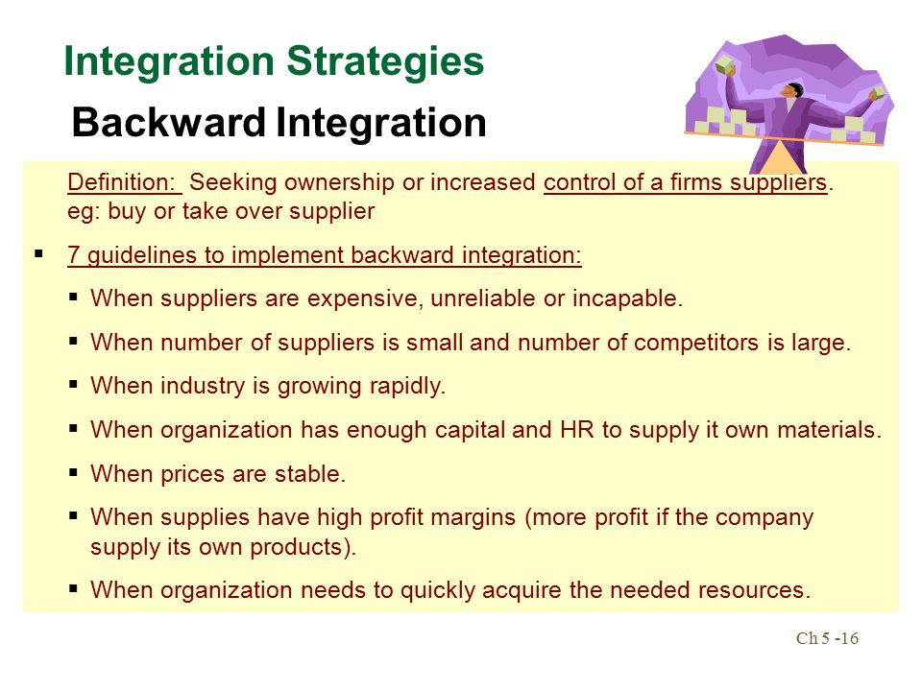

Slide 35
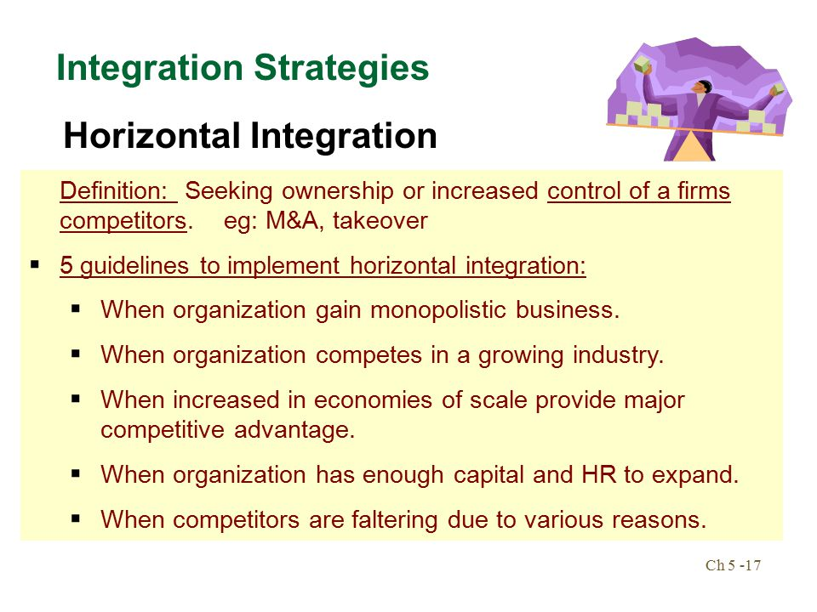

Slide 36


Slide 37
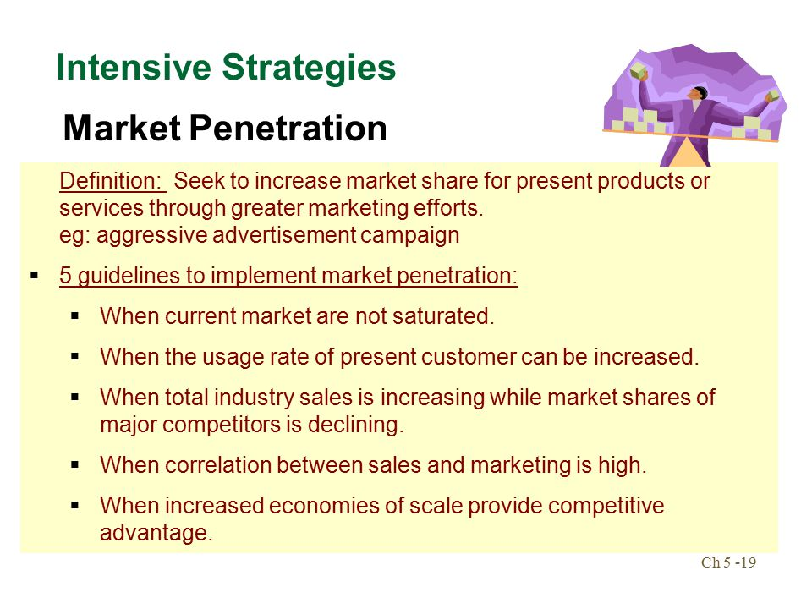

Slide 38
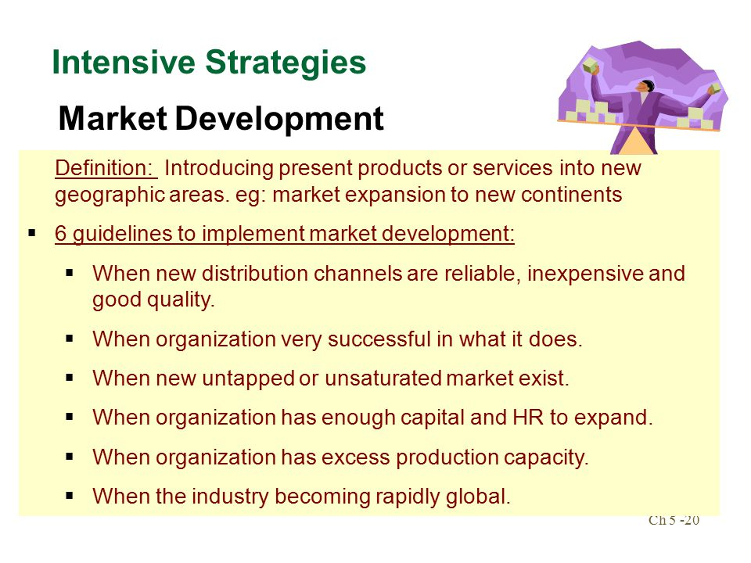

Slide 39
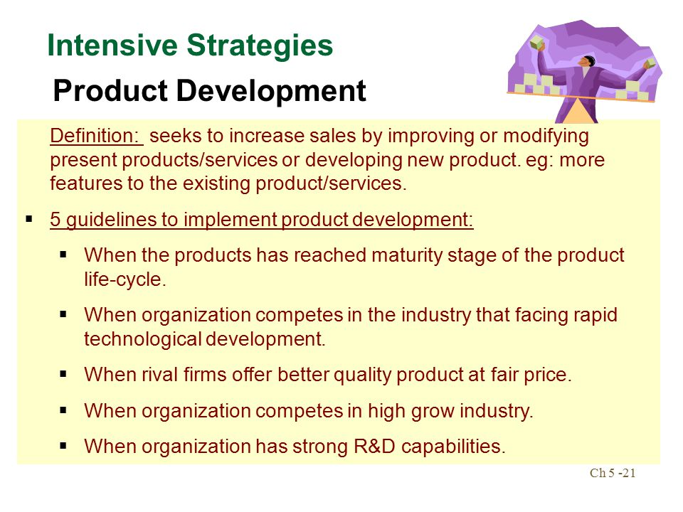

Slide 40
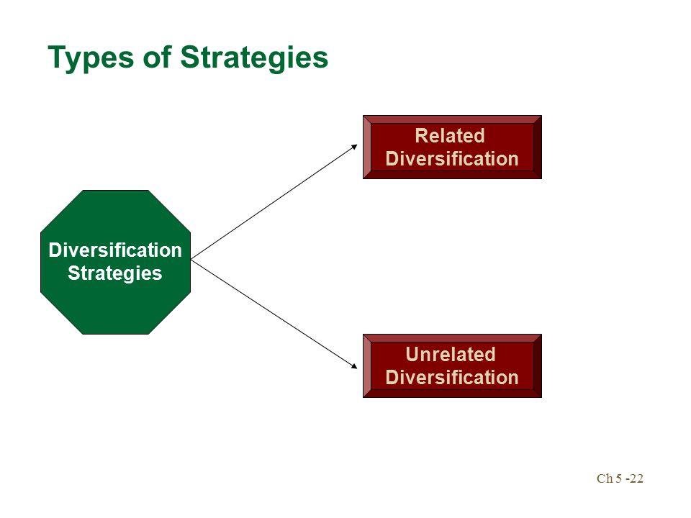

Slide 41
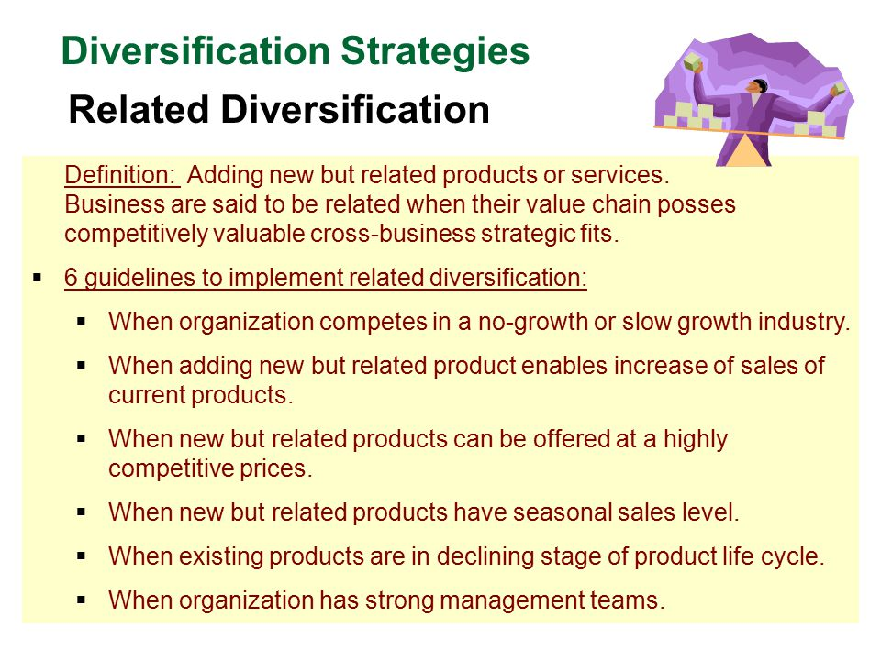

Slide 42
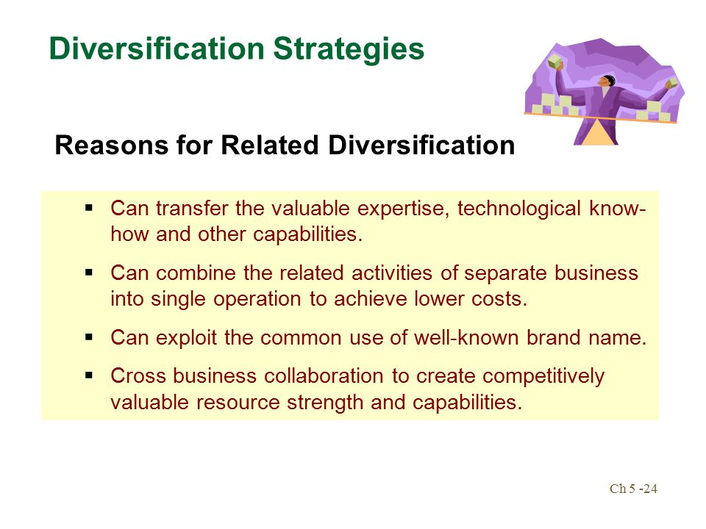

Slide 43
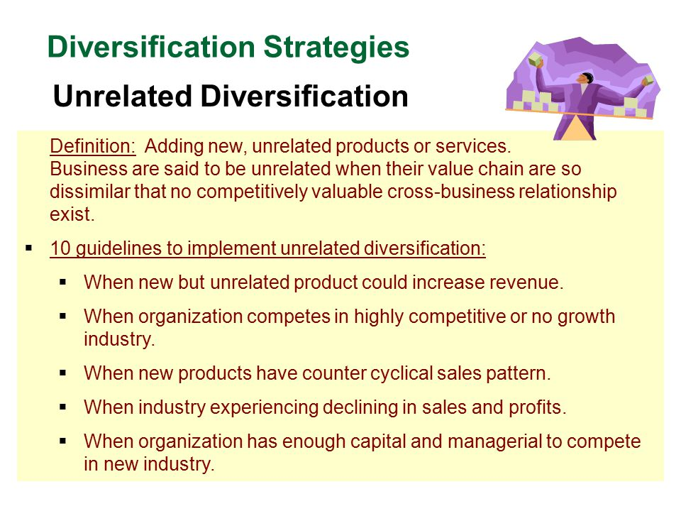

Slide 44
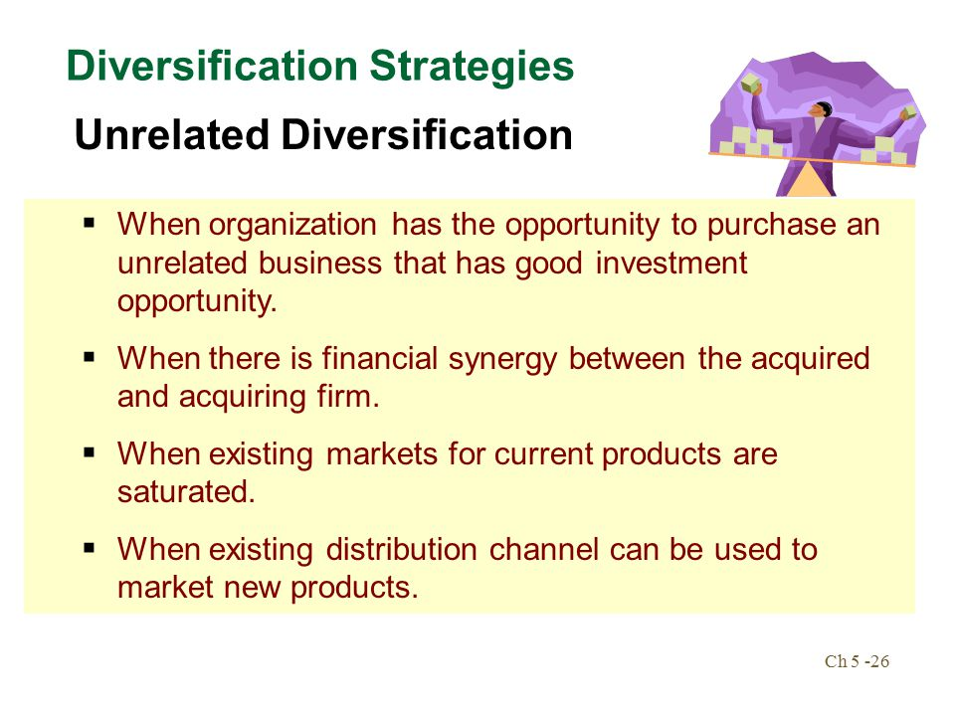

Slide 45
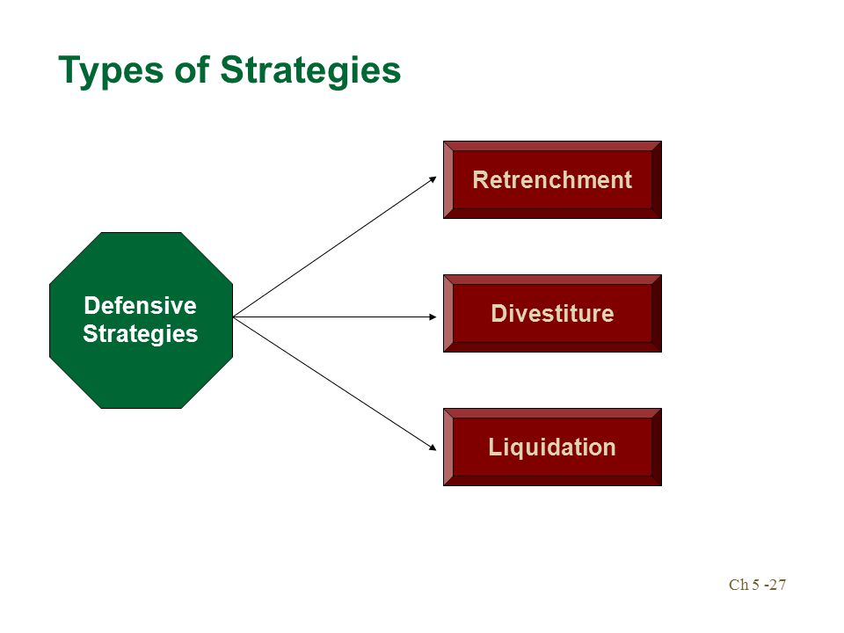

Slide 46
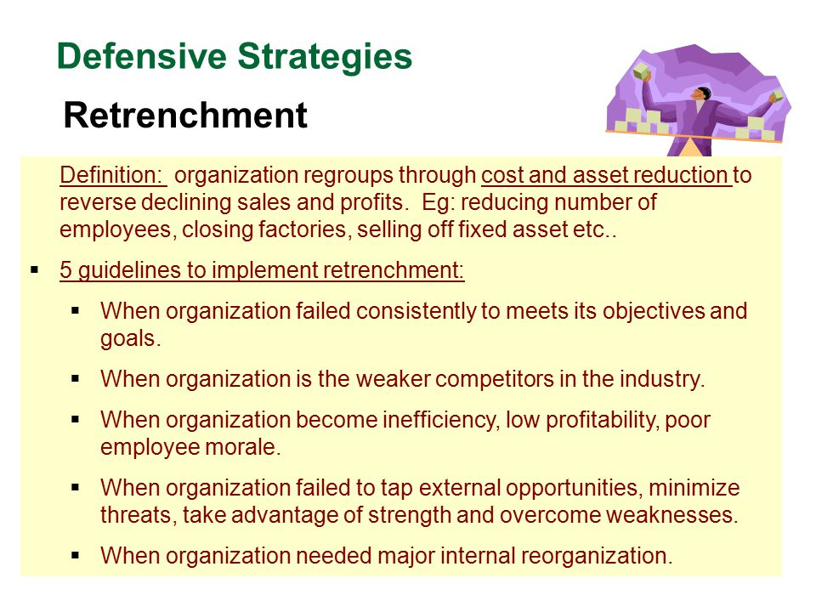

Slide 47
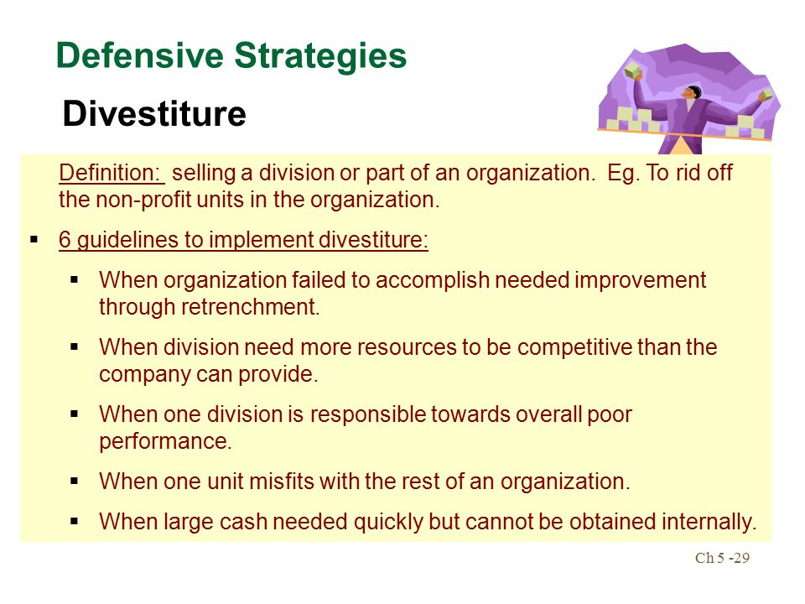

Slide 48
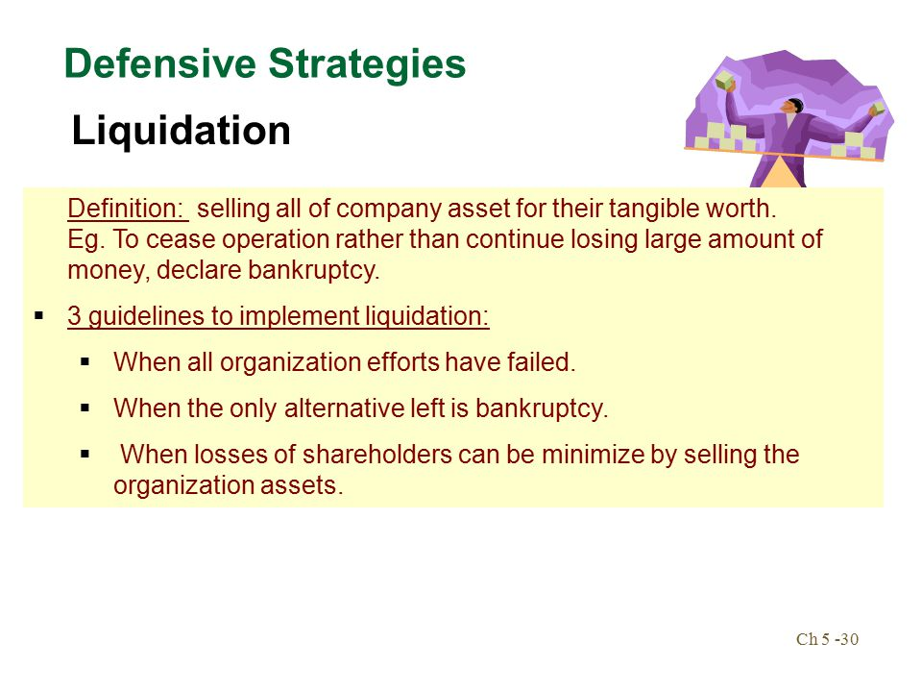

Slide 49
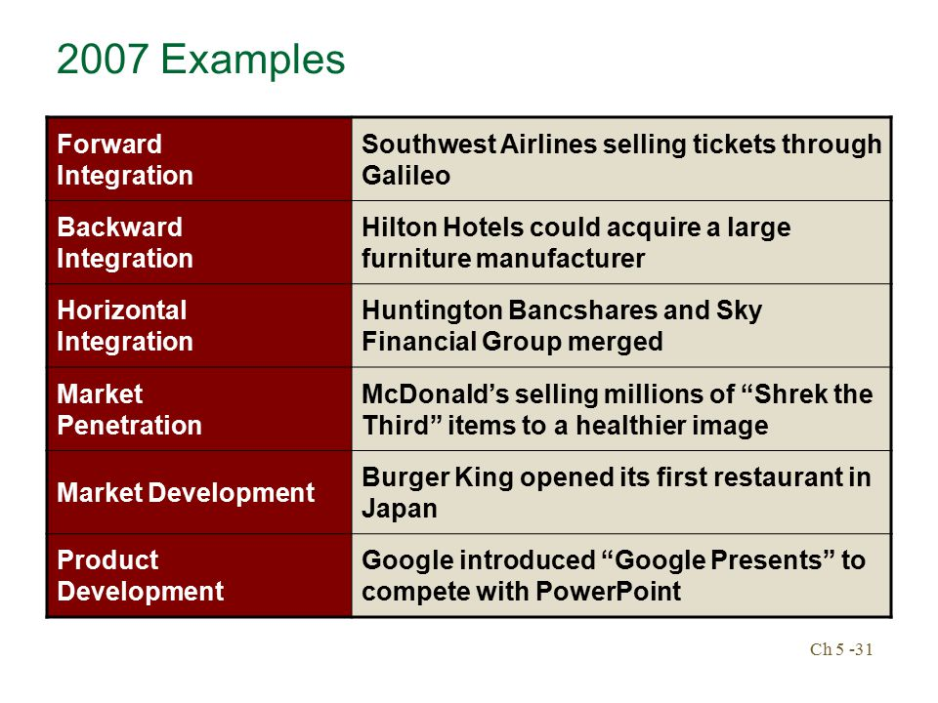

Slide 50
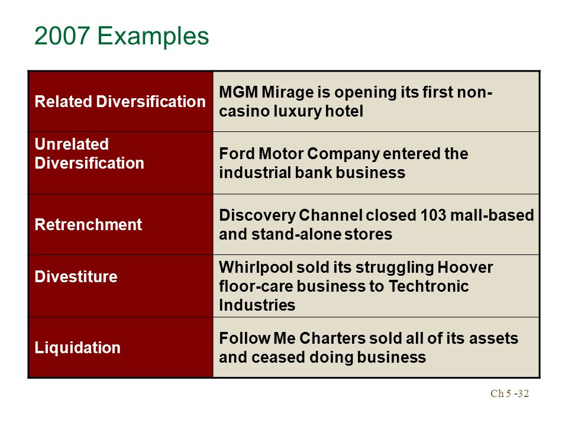

Slide 51
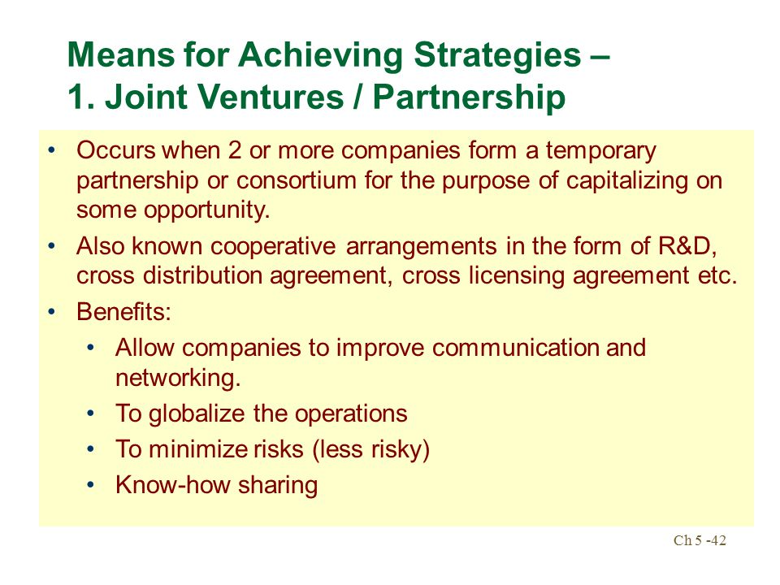

Slide 52
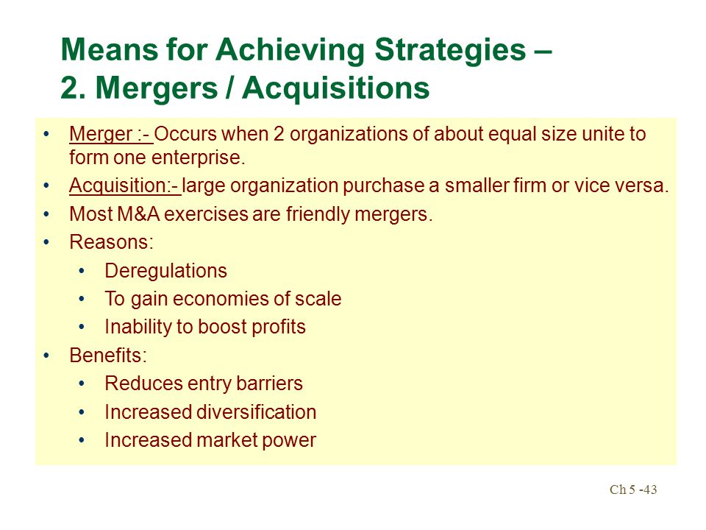

Slide 53
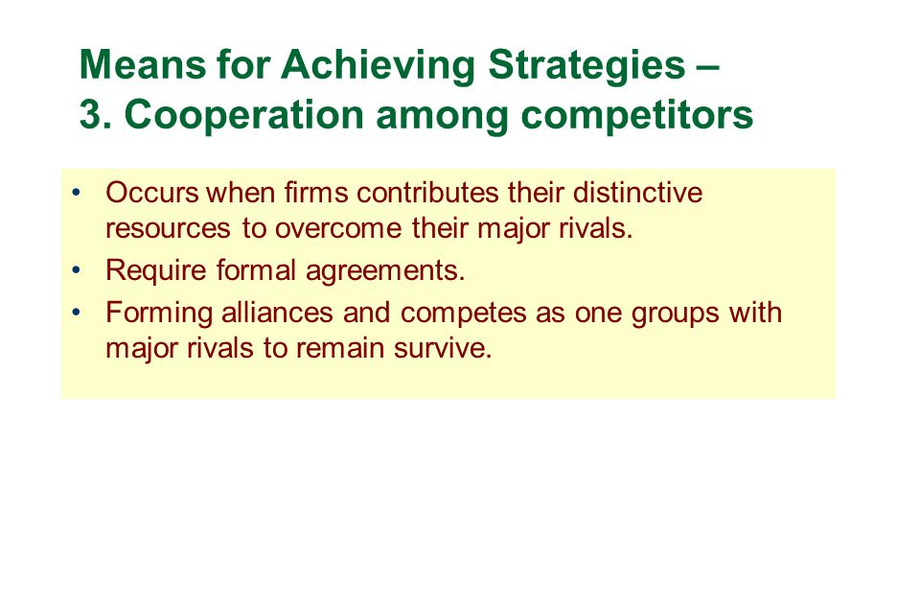

Slide 54
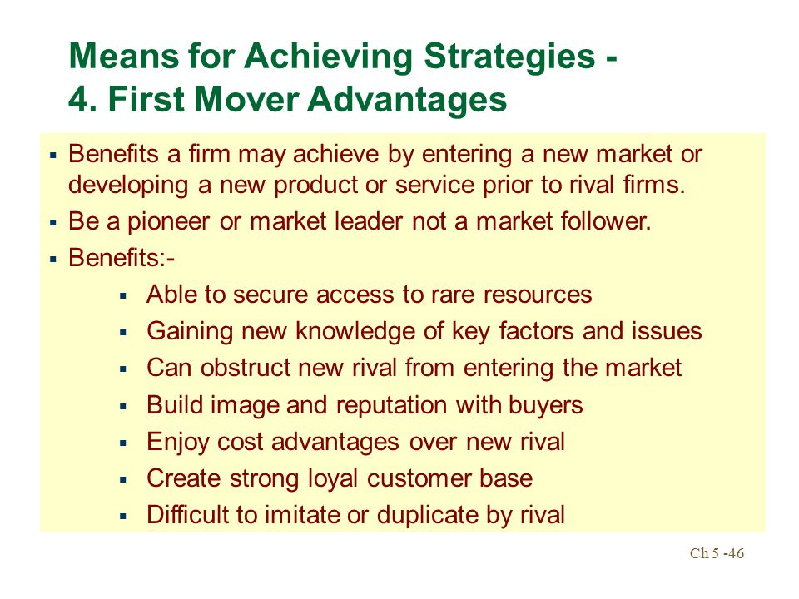

Slide 55
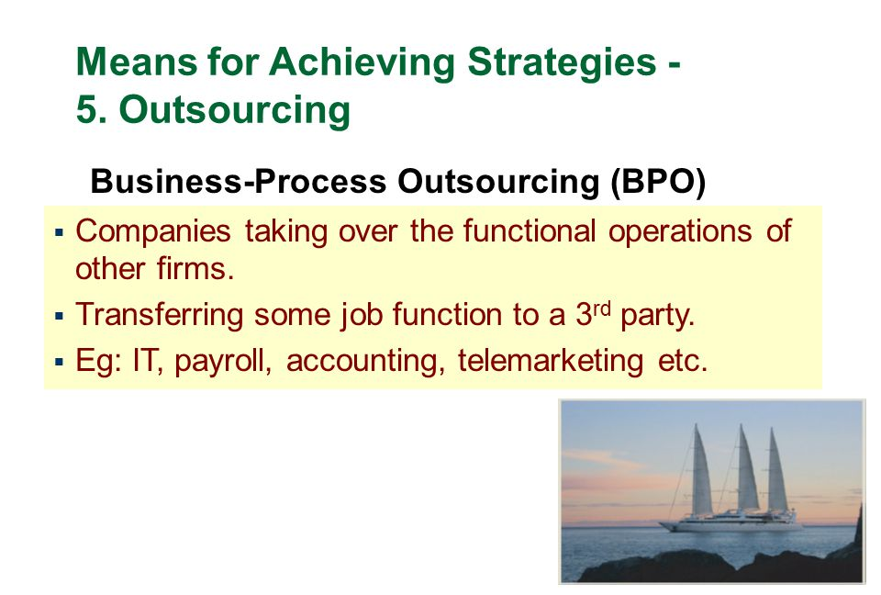

Slide 56
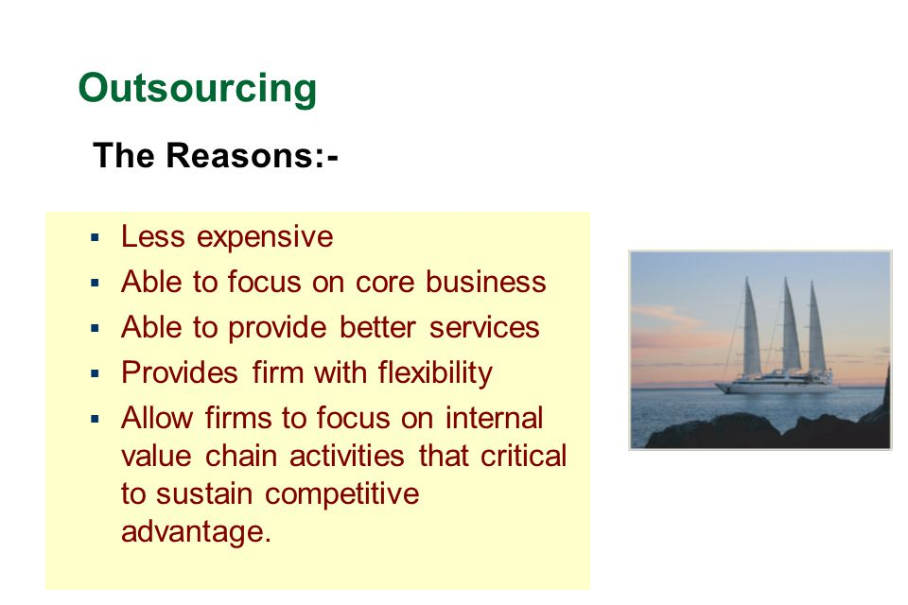

Slide 57
Qualities of Long-Term Objectives
There are seven criteria that should be used in preparing long-term objectives:
  Acceptable
  Flexible
  Measurable over time
  Motivating
  Suitable
  Understandable
  Achievable

Slide 58
Strategy and Competitive Advantage
Competitive advantage exists when a firm’s strategy gives it an edge in
  Attracting customers and
  Defending against competitive forces
Convince customers firm’s product / service offers superior value
  A good product at a low price
  A superior product worth paying more for
  A best-value product
Key to Gaining a Competitive Advantage

Slide 59
Sources of Competitive Advantage
Competitive Advantages
(Sources of Rates of Profit in Excess of the Competitive Level)
Avoid
Competitors
Be Better Than
Competition
Attractive
Industry
Attractive
Strategic Group
Attractive
Niche
Cost
Advantage
Differentiation
Advantage
Entry Barriers
Mobility Barriers
Isolating Mechanisms
Notes:
2

Slide 60
Porter’s Generic Strategies
Generic strategies - help ‘position’ the firm to best advantage
Overall cost leadership strategy – seeks to be lowest cost provider
Differentiation strategy – seeks to create something unique, unmatched by competitors
Focus strategy – seeks to identify a particular segment within the broader market and to dominate that segment

Slide 61
What Is “Competitive Strategy”?
Deals exclusively with a company’s
business plans to compete successfully
  Specific efforts to please customers
  Offensive and defensive moves
  to counter maneuvers of rivals
  Responses to prevailing market conditions
  Initiatives to strengthen its market position
Narrower in scope than business strategy

Slide 62
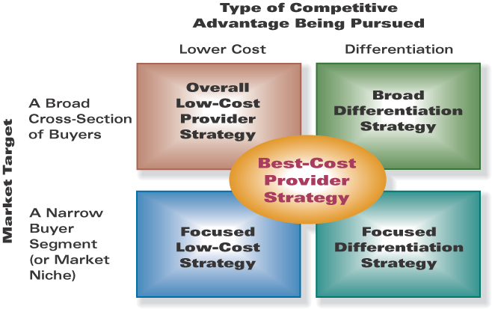
The Five Generic Competitive Strategies

Slide 63
Generic Strategies
A long-term or grand strategy must be based on a core idea about how the firm can best compete in the marketplace. The popular term for this core idea is generic strategy.

Slide 64
3 Generic Strategies
  Striving for overall low-cost leadership in the industry.
  Striving to create and market unique products for varied customer groups through differentiation.
  Striving to have special appeal to one or more groups of consumers or industrial buyers, focusing on their cost or differentiation concerns.

Slide 65
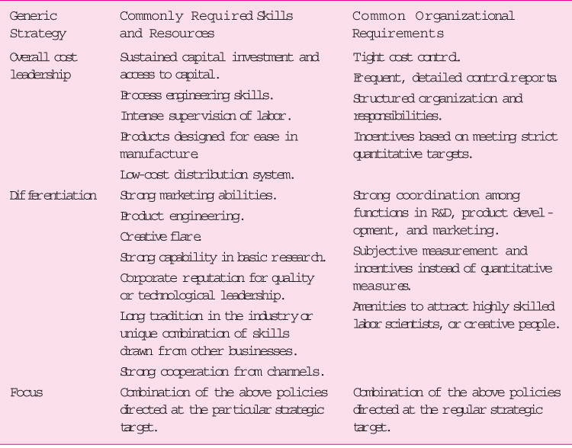
Requirements for
Generic Competitive Strategies

Slide 66
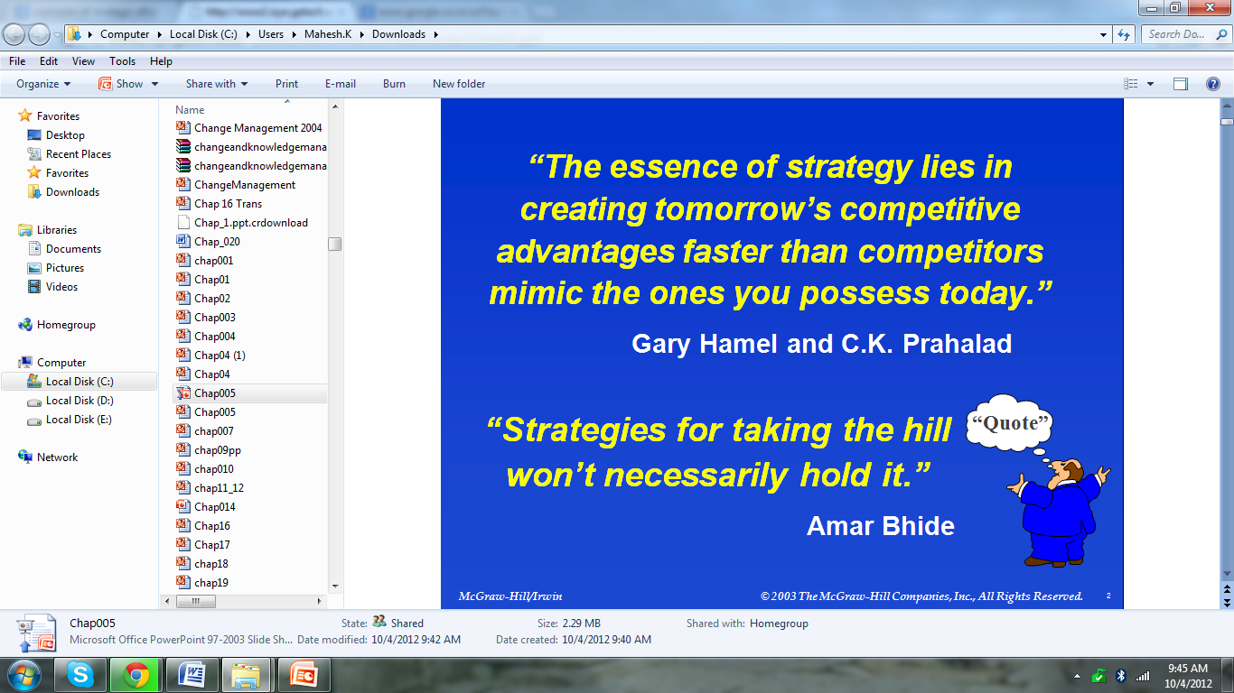

Slide 67
Low-Cost Leadership
Low-cost producers usually excel at cost reductions and efficiencies

Slide 68
They maximize economies of scale, implement cost-cutting technologies, stress reductions in overhead and in administrative expenses, and use volume sales techniques to propel themselves up the earning curve

Slide 69
A low-cost leader is able to use its cost advantage to charge lower prices or to enjoy higher profit margins

Slide 70
Differentiation
Strategies dependent on differentiation are designed to appeal to customers with a special sensitivity for a particular product attribute

Slide 71
By stressing the attribute above other product qualities, the firm attempts to build customer loyalty
Often such loyalty translates into a firm’s ability to charge a premium price for its product

Slide 72
The product attribute also can be the marketing channels through which it is delivered, its image for excellence, the features it includes, and its service network

Slide 73
Focus
A focus strategy, whether anchored in a low-cost base or a differentiation base, attempts to attend to the needs of a particular market segment

Slide 74
A firm pursuing a focus strategy is willing to service isolated geographic areas; to satisfy the needs of customers with special financing, inventory, or servicing problems; or to tailor the product to the somewhat unique demands of the small- to medium-sized customer

Slide 75
The focusing firms profit from their willingness to serve otherwise ignored or underappreciated customer segments

Slide 76
Low-Cost Provider Strategies
Keys to Success
Make achievement of meaningful lower costs
than rivals the theme of firm’s strategy
Include features and services in product
offering that buyers consider essential
Find approaches to achieve a cost advantage
in ways difficult for rivals to copy or match
Low-cost leadership means low
overall costs, not just low
manufacturing or production costs!

Slide 77
Options: Achieving a Low-Cost Advantage
Option 1: Use lower-cost edge to
Under price competitors and attract price-sensitive buyers in enough numbers to increase total profits
Option 2: Maintain present price, be content with present market share, and use lower-cost edge to
Earn a higher profit margin on each unit sold, thereby increasing total profits

Slide 78
Approaches to Securing a
Cost Advantage
Approach 1
Do a better job than rivals of performing value chain activities efficiently and cost effectively
Revamp value chain to bypass cost-producing activities that add little value from the buyer’s perspective
Approach 2

Slide 79
Keys to Success in Achieving
Low-Cost Leadership
Scrutinize each cost-creating activity, identifying cost drivers
Use knowledge about cost drivers to manage
costs of each activity down year after year
Find ways to restructure value chain to eliminate
nonessential work steps and low-value activities

Slide 80
Work diligently to create cost-conscious corporate cultures
  Feature broad employee participation in continuous cost-improvement efforts and limited perks for executives
  Strive to operate with exceptionally small corporate staffs
Aggressively pursue investments in resources and capabilities that promise to drive costs out of the business

Slide 81

Differentiation Strategies
Objective
Incorporate differentiating features that cause buyers to prefer firm’s product or service over brands of rivals
Find ways to differentiate that create value for buyers and are not easily matched or cheaply copied by rivals
Not spending more to achieve differentiation
than the price premium that can be charged
Keys to Success

Slide 82
Benefits of Successful Differentiation
A product / service with unique, appealing attributes allows a firm to
  Command a premium price and/or
  Increase unit sales and/or
  Build brand loyalty
= Competitive Advantage
Which
hat is unique?

Slide 83
Types of Differentiation Themes
Unique taste -- KFC
Multiple features -- Microsoft Windows and Office
Wide selection and one-stop shopping -- BIGBAZAR
Superior service – FedEx
Spare parts availability -- Caterpillar
More for your money -- McDonald’s
Prestige -- Rolex
Quality manufacture -- Honda, Toyota
Technological leadership -- 3M Corporation
Top-of-line image -- INFY

Slide 84
Sustaining Differentiation: Keys to Competitive Advantage
Most appealing approaches to differentiation
  Those hardest for rivals to match or imitate
  Those buyers will find most appealing
Best choices to gain a longer-lasting, more profitable competitive edge
  New product innovation
  Technical superiority
  Product quality and reliability
  Comprehensive customer service
  Unique competitive capabilities

Slide 85
Best-Cost Provider Strategies
Combine a strategic emphasis on low-cost with a strategic emphasis on differentiation
  Make an upscale product at a lower cost
  Give customers more value for the money
Deliver superior value by meeting or exceeding buyer expectations on product attributes and beating their price expectations
Be the low-cost provider of a product with good-to-excellent product attributes, then use cost advantage to underprice comparable brands
Objectives

Slide 86
Competitive Strength of a
Best-Cost Provider Strategy
A best-cost provider’s competitive advantage comes from matching close rivals on key product attributes and beating them on price
Success depends on having the skills and capabilities to provide attractive performance and features at a lower cost than rivals
A best-cost producer can often out-compete both
a low-cost provider and a differentiator when
  Standardized features/attributes
  won’t meet diverse needs of buyers
  Many buyers are price and value sensitive

Slide 87
Risk of a Best-Cost
Provider Strategy
A best-cost provider may get squeezed between strategies of firms using low-cost and differentiation strategies
  Low-cost leaders may be able to siphon
  customers away with a lower price
  High-end differentiators may be able to
  steal customers away with better product attributes

Slide 88
Focus / Niche Strategies
Involve concentrated attention on a narrow piece of the total market
Serve niche buyers better than rivals
Choose a market niche where buyers have distinctive preferences, special requirements, or unique needs
Develop unique capabilities to serve needs of target buyer segment
Objective
Keys to Success

Slide 89
Approaches to Defining Market Niche
Geographic uniqueness
Specialized requirements in
using product/service
Special product attributes
appealing only to niche buyers

Slide 90
Focus / Niche Strategies and Competitive Advantage
Approach 1
Achieve lower costs than
rivals in serving the segment --
A focused low-cost strategy
Approach 2
Offer niche buyers something
different from rivals --
A focused differentiation strategy
Which hat is unique?

Slide 91
Deciding Which Generic Competitive Strategy to Use
Each positions a company differently in its market
Each establishes a central theme for how a company will endeavor to outcompete rivals
Each creates some boundaries for maneuvering as market circumstances unfold
Each points to different ways of experimenting with the basics of the strategy
Each entails differences in product line, production emphasis, marketing emphasis, and means to sustain the strategy
The big risk – Selecting a “stuck in the middle” strategy!
This rarely produces a sustainable competitive
advantage or a distinctive competitive position.

Slide 92
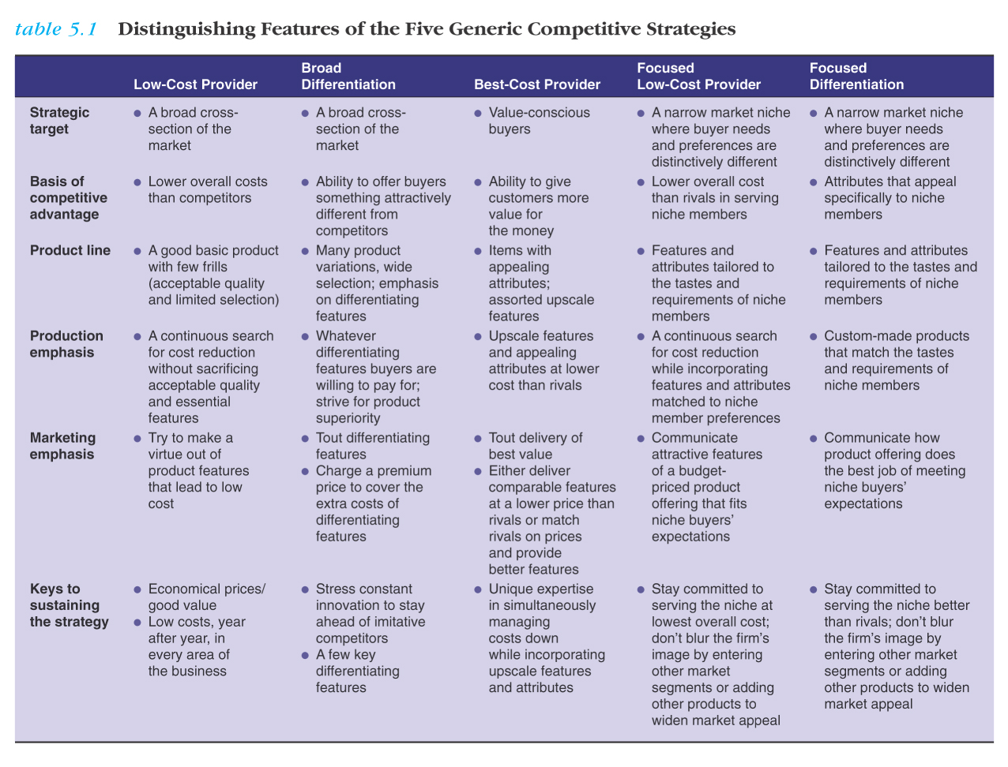

Slide 93
Generic Strategy
Grand Strategy
Strategic Alliance
Collaborative Partnership
Mergers & Acquisition Strategy
Joint Ventures
Outsourcing strategy
GE Nine Cell
BCG Matrix

Slide 94
Strategic Alliance & Collaborative Partnership
The basic idea behind formation of a strategic alliance is to generate synergistic effect which helps in generating competitive advantage.
This is based on the idea that “ If you can’t do a thing alone, join hands with others.” It is for a specific task or for a specific period without having equity interest.
It aims at creating a win-win situation for all partners.

Slide 95
Why Strategic Alliance?
Adding value to products/services
Improving market access
Strengthening operations
Adding technological strength
Enhancing strategic growth
Building financial strength

Slide 96
Stages of Strategic Alliance
Initial Euphoria
Honeymoon period
Dawning realization
Aftershock
Damage control

Slide 97
The reasons for Strategic Alliances are
It brings different competencies of partners together.
This combination of competencies is able to produce better results as compared to the sum total of the results of individual organizations competencies taken together.

Slide 98
In the age of changing technology and markets forces, all organizations cannot develop matching competencies. Therefore, in order to match environmental requirements, they join hand with others to complement their competencies.

Slide 99
In many cases, new product development costs are quite high. In order to bear such costs, many organizations collaborate among themselves, share costs and outcomes of new products.

Slide 100
Sometimes, global alliance are formed with organizations of another country to ease entry barriers as local organizations may be well aware about the local business conditions.
Strategic alliance are formed to create opportunities to learn either the new way of doing a thing or doing new thing.

Slide 101
For success the essentials are
Each partner should have Trust between them and no suspicion.
Good understanding between partners. When the business shows downtrend, there will be more mis-understanding and quarrels leading to litigation.
Partrners should not compete each other. There should be transparency and limitations in their own accepted duties. No intervention.

Slide 102
Collaborative Partners
Any alliance is passable with minimum two partners and any number of partners with the Core Competence (competitive skills), commitment and expertised back ground on these lines

Slide 103
There are essential qualifications that make the Partnership successful.
A corporate-level growth strategy in which two or more firms agree to share the costs, risks and benefits associated with pursuing new business opportunities. The strategic alliances are often referred to as partnership

Slide 104
Factors should be considered in choosing alliance partners
Drivers - What benefit are offered by collaboration?
Partners - Which partners should be chosen?
Facilitators - Does the external environment favor a partnership?
Components - Activities and processes in the network.
Effectiveness - Does the previous history of alliances generate good results?
Market Orientation – Whether partners are harder to control and may not have the same commitment to the end user?

Slide 105
Selection of the right kind of partner is the most essential part of Strategic Alliance.
a good partner helps the Co achieve strategic goals such as achieving market access,
(1)share the costs and risk of new product development, or gaining access to critical core competencies.
(2) A good partner shares the firm’s vision for the purpose of the alliance. This will make them firmly united and holds good relations.

Slide 106
(3) A good partner is unlikely to try to exploit the alliance opportunistically for its self interest.
Giving little to the partner where more is to be given – technical know how. All these verification can be made by referring their behavior with earlier partnership with other firms.

Slide 107
Mergers & Acquisition Strategy
Merger or Amalgamation: is the integration of two or more business. Is also the joining of two separate Cos to form a single Co – an external strategy for growth of the organization.
A corporate-level growth strategy in which a firm combines with another firm through an exchange of stock.

Slide 108
A merger occurs when two or more firms, usually of similar sizes, combine into one through an exchange of stock.
Mergers are generally undertaken to share or transfer resources and or improve competitiveness by developing synergy. The name of the merged Co will go after merging. There will be one Company i.e. Merger.

Slide 109
Reasons for Merger
Quick entry in the business.- There is no gestation time and familiarity of the product or service to the market and customers.
Faster Growth Rate - The volume of business can be raised rapidly with less risk. You can overcome a competitors in certain cases. Ready utilities like production, marketing, distribution, research & Development.
Diversification Advantages - If the acquiring Co or Merger Co wants to diversify

Slide 110
they can takeover the same product Co and enter into the business with less time..
Reduction in Competitors and Dependence - You can eliminate Competitors and increase in your market share. You can enjoy a ready market.

Slide 111
Tax advantage - If the merged Co possessing accumulated losses can be set off by the Merger Co.
Synergistic Advantages - The complementary capabilities can be achieved like
2 + 2 = 5 in Marketing, investment, operating (utilization of common facilities,
personnel, overheads, inventories etc), Common Management and avoiding
duplicating of managerial and other personnel.

Slide 112
JOINT VENTURE
A joint venture (often abbreviated JV) is an entity formed between two or more parties to undertake economic activity together.
The parties agree to create a new entity by both contributing equity, and they then share in the revenues, expenses, and control of the enterprise.

Slide 113
The venture can be for one specific project only, or a continuing business relationship such as the Fuji Xerox joint venture.
This is in contrast to a strategic alliance, which involves no equity stake by the participants, and is a much less rigid arrangement.

Slide 114
The solution is a set of joint ventures, which are commercial companies (children) created and operated for the benefit of the co-owners (parents)

Slide 115
The joint venture extends the supplier-consumer relationship and has strategic advantages for both partners

Slide 116
Types of International Joint Ventures
Traditional equity joint-venture
  Two parents from two different countries
Trinational
  Two parents from two different countries, set up a venture in a third country
Cross-national
  Two parents of same nationality, venture located in a different country

Slide 117
Motives for IJV Formation
To take existing products to new markets
To diversify into a new business
Existing Markets New Markets
To strengthen the existing business
To bring foreign products to local markets
Existing Products New Products

Slide 118
Partners’ Contributions
Complementary skills
  Unique and continuing contributions
  Once skills are redundant, IJV may be terminated
  Different logics in different firms
    Learning races (biotech firms)
    Long-term relationships (buyer-supplier relationships)
Cooperative cultures
  Work together for joint benefit
  Avoid decision-making stalemates
  Avoid a confrontational stance
Seek similarities among the partners when possible (size, industry, rural vs. urban location, functional background)

Slide 119
Joint Ventures - Plus
Gain “local” knowledge/access.
  In-depth knowledge local market.
  Distribution system.
  Access to low-cost labor or raw materials.
  Technology/Manufacturing/Process know-how.
Fewer resources required.
Risk reduction:
  Less capital exposed.
  Looks “better” to government.
Sometimes the only way in.

Slide 120
OUTSOURCING
Outsourcing is subcontracting a process, such as product design or manufacturing, to a third-party company.
The decision to outsource is often made in the interest of lowering cost or making better use of time and energy costs, redirecting or conserving energy directed at the competencies of a particular business, or to make more efficient use of land, labor, capital, (information) technology and resources.
Outsourcing became part of the business lexicon during the 1980s.
It is essentially a division of labour.

Slide 121
Outsourcing involves the transfer of the management and/or day-to-day execution of an entire business function to an external service provider.
The client organization and the supplier enter into a contractual agreement that defines the transferred services.
Under the agreement the supplier acquires the means of production in the form of a transfer of people, assets and other resources from the client.

Slide 122
The client agrees to procure the services from the supplier for the term of the contract.
Business segments typically outsourced include information technology, human resources, facilities, real estate management, and accounting.
Many companies also outsource customer support and call center functions like telemarketing, CAD drafting, customer service, market research, manufacturing, designing, web development, content writing and engineering.

Slide 123
The Top Five Strategic Reasons for Outsourcing
Improve business focus
Access to world-class capabilities
Accelerated reengineering benefits
Shared risks
Free resources for other purposes

Slide 124
Strategic Alliances
Strategic alliances are distinguished from joint ventures because the companies involved do not take an equity position in one another

Slide 125
In some instances, strategic alliances are synonymous with licensing agreements
Outsourcing arrangements vary

Slide 126
Consortia
Consortia are defined as large interlocking relationships between businesses of an industry
In Japan such consortia are known as keiretsus, in South Korea as chaebols
Their cooperative nature is growing in evidence as is their market success

Slide 127
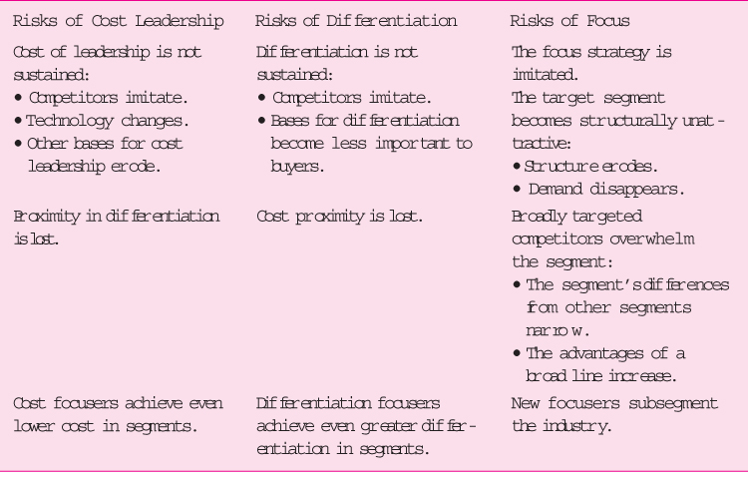
Risks of the Generic Strategies

Slide 128
The Value Disciplines
Operational Excellence
  This strategy attempts to lead the industry in price and convenience by pursuing a focus on lean and efficient operations
Customer Intimacy
  Customer intimacy means continually tailoring and shaping products and services to fit an increasingly refined definition of the customer
Product Leadership
  Companies that pursue the discipline of product leadership strive to produce a continuous state of state-of-the-art products and services

Slide 129
Grand Strategies
Grand strategies, often called master or business strategies, provide basic direction for strategic actions
Indicate the time period over which long-rang objectives are to be achieved
Any one of these strategies could serve as the basis for achieving the major long-term objectives of a single firm
Firms involved with multiple industries, businesses, product lines, or customer groups usually combine several grand strategies

Slide 130

Concentrated Growth
Concentrated growth is the strategy of the firm that directs its resources to the profitable growth of a single product, in a single market, with a single dominant technology
Concentrated growth strategies lead to enhanced performance
Specific conditions favor concentrated growth
The risks and rewards vary

Slide 131
Market Development
Market development commonly ranks second only to concentration as the least costly and least risky of the 15 grand strategies
It consists of marketing present products, often with only cosmetic modifications, to customers in related market areas by adding channels of distribution or by changing the content of advertising or promotion
Frequently, changes in media selection, promotional appeals, and distribution are used to initiate this approach

Slide 132

Product Development
Product development involves the substantial modification of existing products or the creation of new but related products that can be marketed to current customers through established channels

Slide 133
Innovation
These companies seek to reap the initially high profits associated with customer acceptance of a new or greatly improved product
Then, rather than face stiffening competition as the basis of profitability shifts from innovation to production or marketing competence, they search for other original or novel ideas
The underlying rationale of the grand strategy of innovation is to create a new product life cycle and thereby make similar existing products obsolete

Slide 134
Horizontal Integration
When a firm’s long-term strategy is based on growth through the acquisition of one or more similar firms operating at the same stage of the production-marketing chain, its grand strategy is called horizontal integration
Such acquisitions eliminate competitors and provide the acquiring firm with access to new markets

Slide 135
Vertical Integration
When a firm’s grand strategy is to acquire firms that supply it with inputs (such as raw materials) or are customers for its outputs (such as warehouses for finished products), vertical integration is involved
The main reason for backward integration is the desire to increase the dependability of the supply or quality of the raw materials used as production inputs

Slide 136
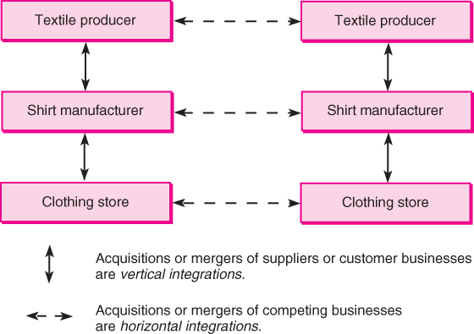
Vertical and Horizontal Integration

Slide 137
Concentric Diversification
Concentric diversification involves the acquisition of businesses that are related to the acquiring firm in terms of technology, markets, or products
With this grand strategy, the selected new businesses possess a high degree of compatibility with the firm’s current businesses
The ideal concentric diversification occurs when the combined company profits increase the strengths and opportunities and decrease the weaknesses and exposure to risk (BB-Lipton)

Slide 138
Conglomerate Diversification
Occasionally a firm, particularly a very large one, plans acquire a business because it represents the most promising investment opportunity available. This grand strategy is commonly known as conglomerate diversification.
The principal concern of the acquiring firm is the profit pattern of the venture
Unlike concentric diversification, conglomerate diversification gives little concern to creating product-market synergy with existing businesses
(Bharathi-MTN,Mittal-Arcelar)

Slide 139
Turnaround
The firm finds itself with declining profits
Among the reasons are economic recessions, production inefficiencies, and innovative breakthroughs by competitors
Strategic managers often believe the firm can survive and eventually recover if a concerted effort is made over a period of a few years to fortify its distinctive competences. This is turnaround.
Two forms of retrenchment:
  Cost reduction
  Asset reduction

Slide 140
Elements of Turnaround
A turnaround situation represents absolute and relative-to-industry declining performance of a sufficient magnitude to warrant explicit turnaround actions
The immediacy of the resulting threat to company survival is known as situation severity
Turnaround responses among successful firms typically include two stages of strategic activities: retrenchment and the recovery response
The primary causes of the turnaround situation have been associated with the second phase of the turnaround process, the recovery response

Slide 141
Divestiture
A divestiture strategy involves the sale of a firm or a major component of a firm
When retrenchment fails to accomplish the desired turnaround, or when a nonintegrated business activity achieves an unusually high market value, strategic managers often decide to sell the firm
Reasons for divestiture vary

Slide 142
Liquidation
When liquidation is the grand strategy, the firm typically is sold in parts, only occasionally as a whole—but for its tangible asset value and not as a going concern
Planned liquidation can be worthwhile (GM)

Slide 143
Bankruptcy
Liquidation bankruptcy—agreeing to a complete distribution of firm assets to creditors, most of whom receive a small fraction of the amount they are owed
Reorganization bankruptcy—the managers believe the firm can remain viable through reorganization
Two notable types of bankruptcy
  Chapter 7
  Chapter 11

Slide 144
Motivations for Diversification
Increase firm’s stock value
Increase growth rate of firm
Investment is better use of funds than using them for internal growth
Improves stability of earnings and sales
Balance or fill out product line
Diversify product line
Acquire a needed resource quickly
Achieve tax savings
Increase efficiency and profitability

Slide 145
Diversification Strategies
Concentric Diversification
Involves acquisition of businesses related to acquiring firm in terms of technology, markets, or products
Conglomerate Diversification
Involves acquisition of a business because it represents a promising investment opportunity
  Primary motivation is profit pattern of venture
Difference between the approaches
  Concentric diversification emphasizes commonality whereas conglomerate diversification emphasizes profits for each individual unit

Slide 146
What Is Unrelated Diversification?
Involves diversifying into businesses with
  No strategic fit
  No meaningful value chain
  relationships
  No unifying strategic theme
Basic approach – Diversify into any industry where potential exists
to realize good financial results
While industry attractiveness and cost-of-entry tests are important, better-off test is secondary

Slide 147
Turnaround Strategy
Involves a concerted effort over a period of time to fortify a firm’s distinctive competencies, returning it to profitability

Slide 148
Terms Used in Turnaround Strategy
A turnaround situation represents absolute and relative-to-industry declining performance of a sufficient magnitude to warrant explicit turnaround actions
The immediacy of the resulting threat to company survival posed by the turnaround situation is known as situation severity
Turnaround responses typically include two stages of strategic activities
  Retrenchment
  Recovery response

Slide 149
Divestiture and Liquidation Strategies
Divestiture Strategy
  Involves selling a firm or a major component of a firm
  Reasons for divestiture
    Partial mismatches between acquired firm and parent firm
    Corporate financial needs
    Government antitrust action
Liquidation Strategy
  Involves selling parts of a firm, usually for its tangible asset value and not as a going concern

Slide 150
The Strategy of Bankruptcy
Two approaches
  Liquidation – Involves complete distribution of a firm’s assets to creditors, most of whom receive a small fraction of amount owed
  Reorganization – Involves creditors temporarily freezing their claims while a firm reorganizes and rebuilds its operations more profitably
Advantage of a reorganization bankruptcy
  Proactive option offering maximum repayment of a firm’s debt in the future if a recovery strategy is successful

Slide 151
Corporate Combination Strategies
Joint Ventures
Involves establishing a third company (child), operated for the benefit of the co-owners (parents)
Strategic Alliance
Involves creating a partnership between two or more companies that contribute skills and expertise to a cooperative project
  Exists for a defined period
  Does not involve the exchange of equity

Slide 152
Corporate Combination Strategies
(contd.)
Consortia are defined as large interlocking relationships between businesses of an industry. In Japan such consortia are known as keiretsus, in South Korea as chaebols
A Japanese keiretsu is an undertaking involving up to 50 different firms that are joined around a large trading company or bank and are coordinated through interlocking directories and stock exchanges
Chaebols are typically financed through government banking groups and largely are run by professional managers trained by participating firms expressly for the job

Slide 153
The Top Five Strategic Reasons for Outsourcing
Improve business focus
Access to world-class capabilities
Accelerated reengineering benefits
Shared risks
Free resources for other purposes

